Slide 1
DTS207TC Database Development and Design
Lecture 6
UML for CW1Q4
Chap 10 Big Data*
Di Zhang, Autumn 2025
Page titles with * will not be assessed

Slide 2
Outline
Big Data
Hadoop

Slide 3
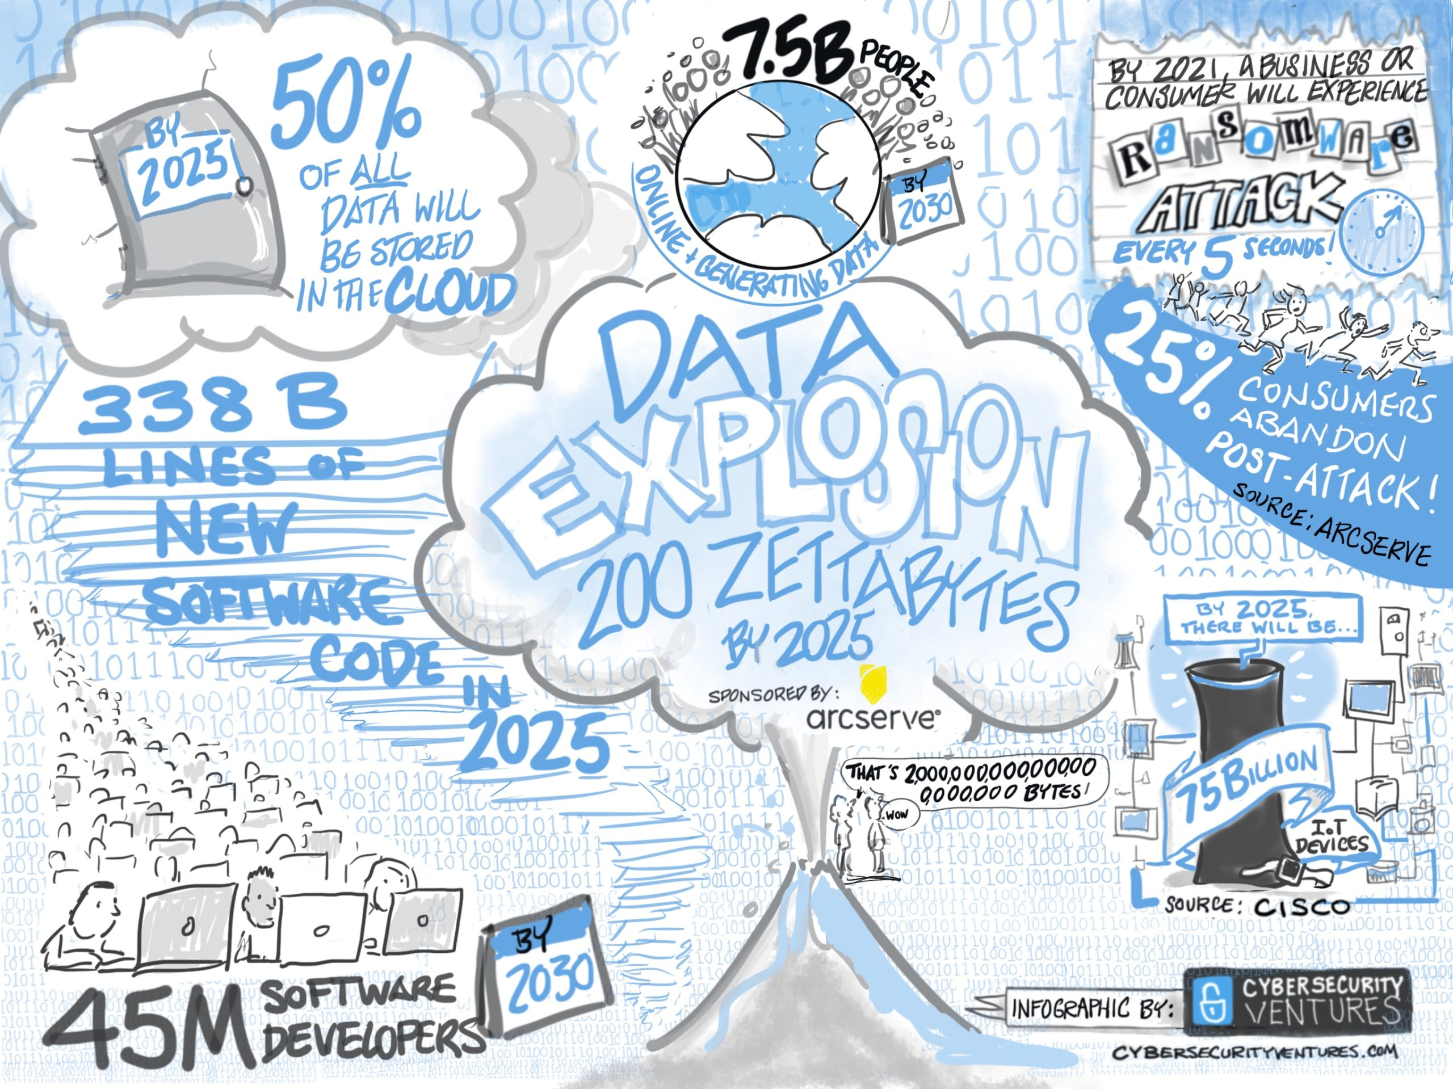

Slide 4
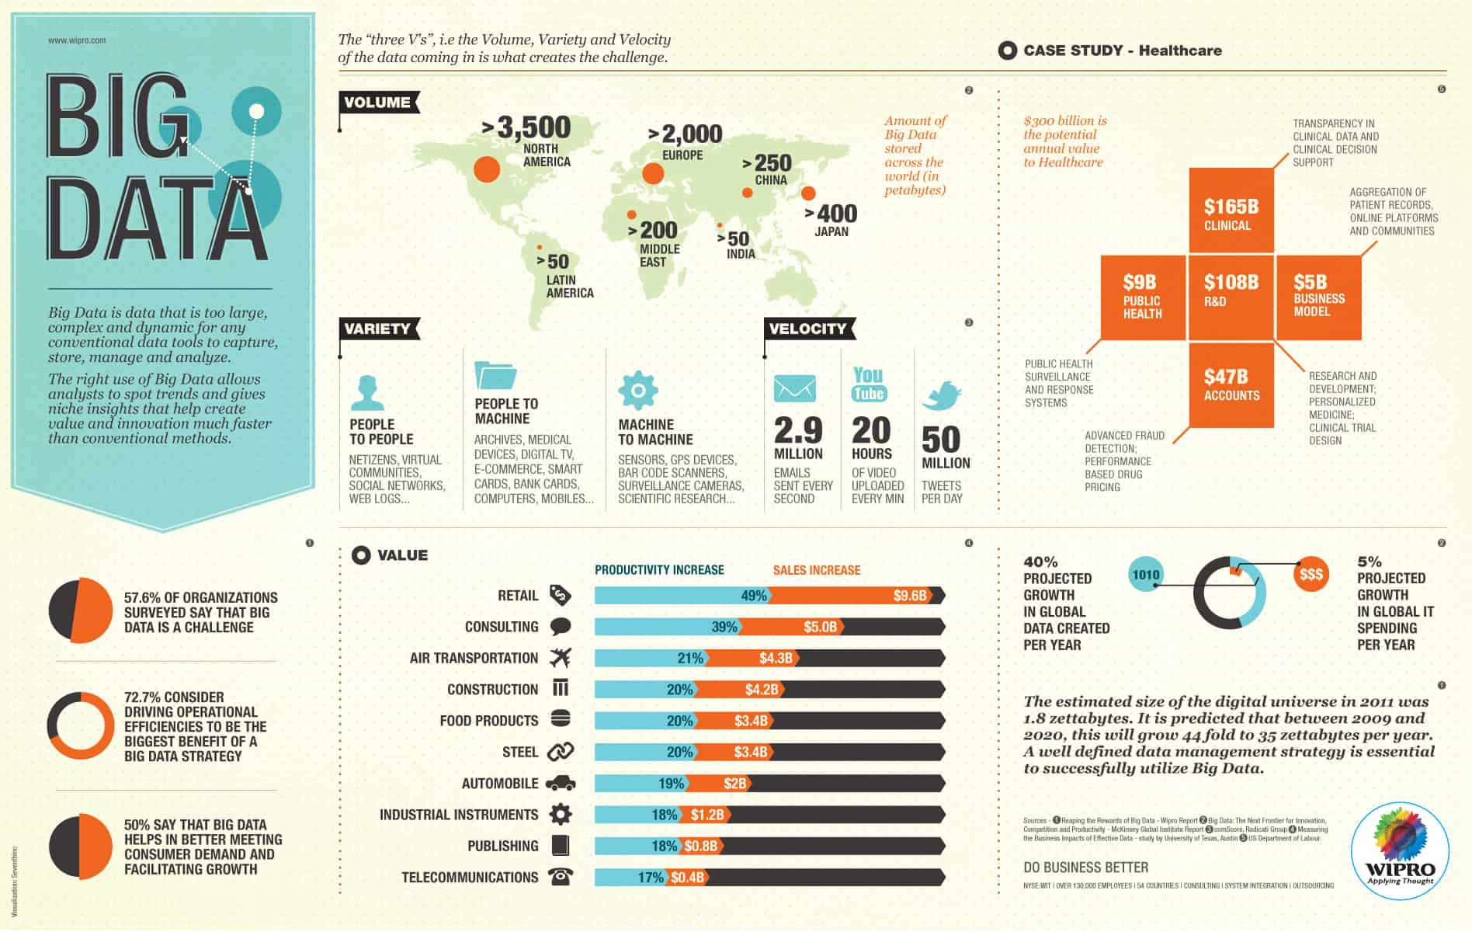

Slide 5
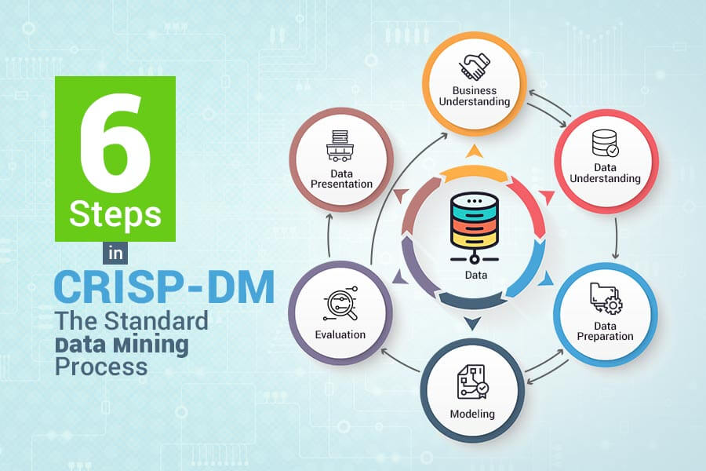

Slide 6
Challenge and Response
Volume
Distributed Computing
Velocity
ACID->BASE: NoSQL
Variety
Unstructed Text
Notes:
https://simple.wikipedia.org/wiki/NoSQL

Slide 7
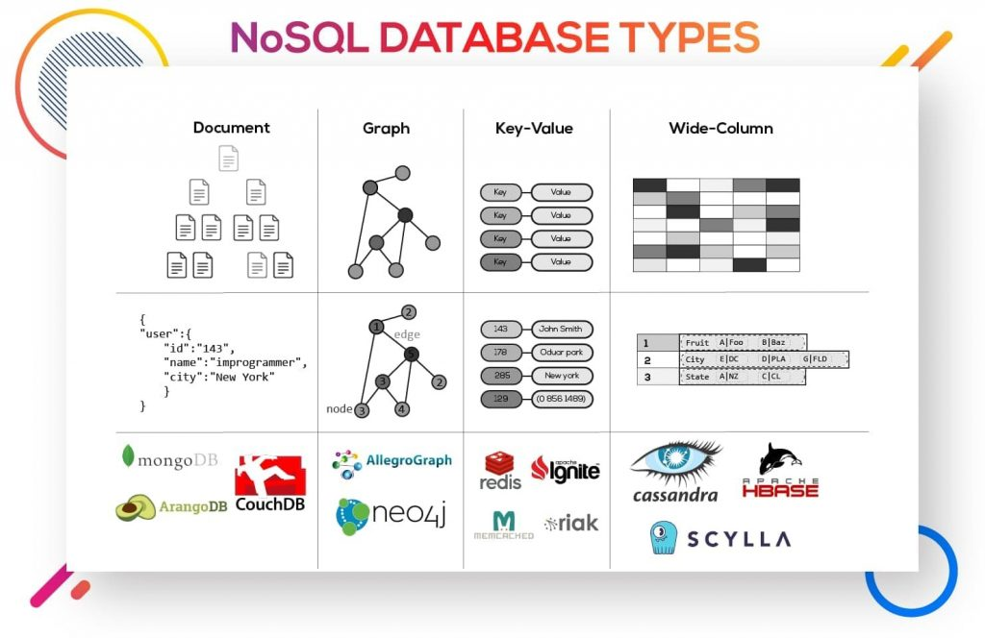

Slide 8
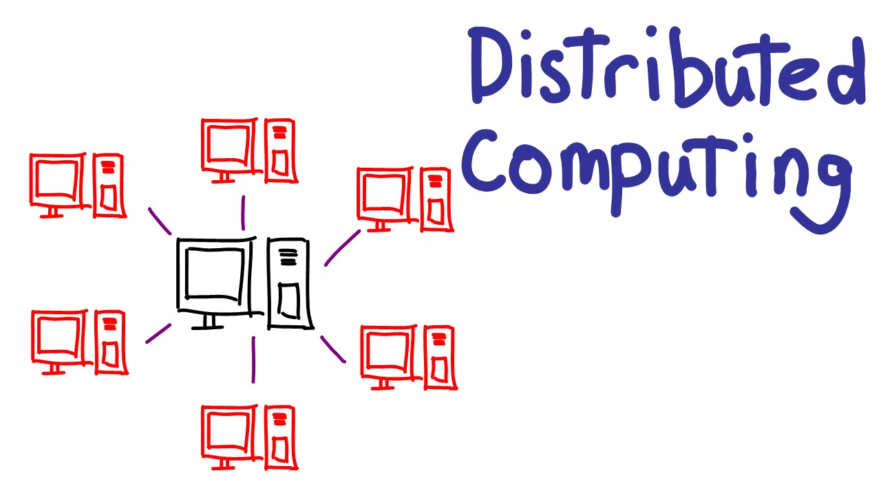

Slide 9
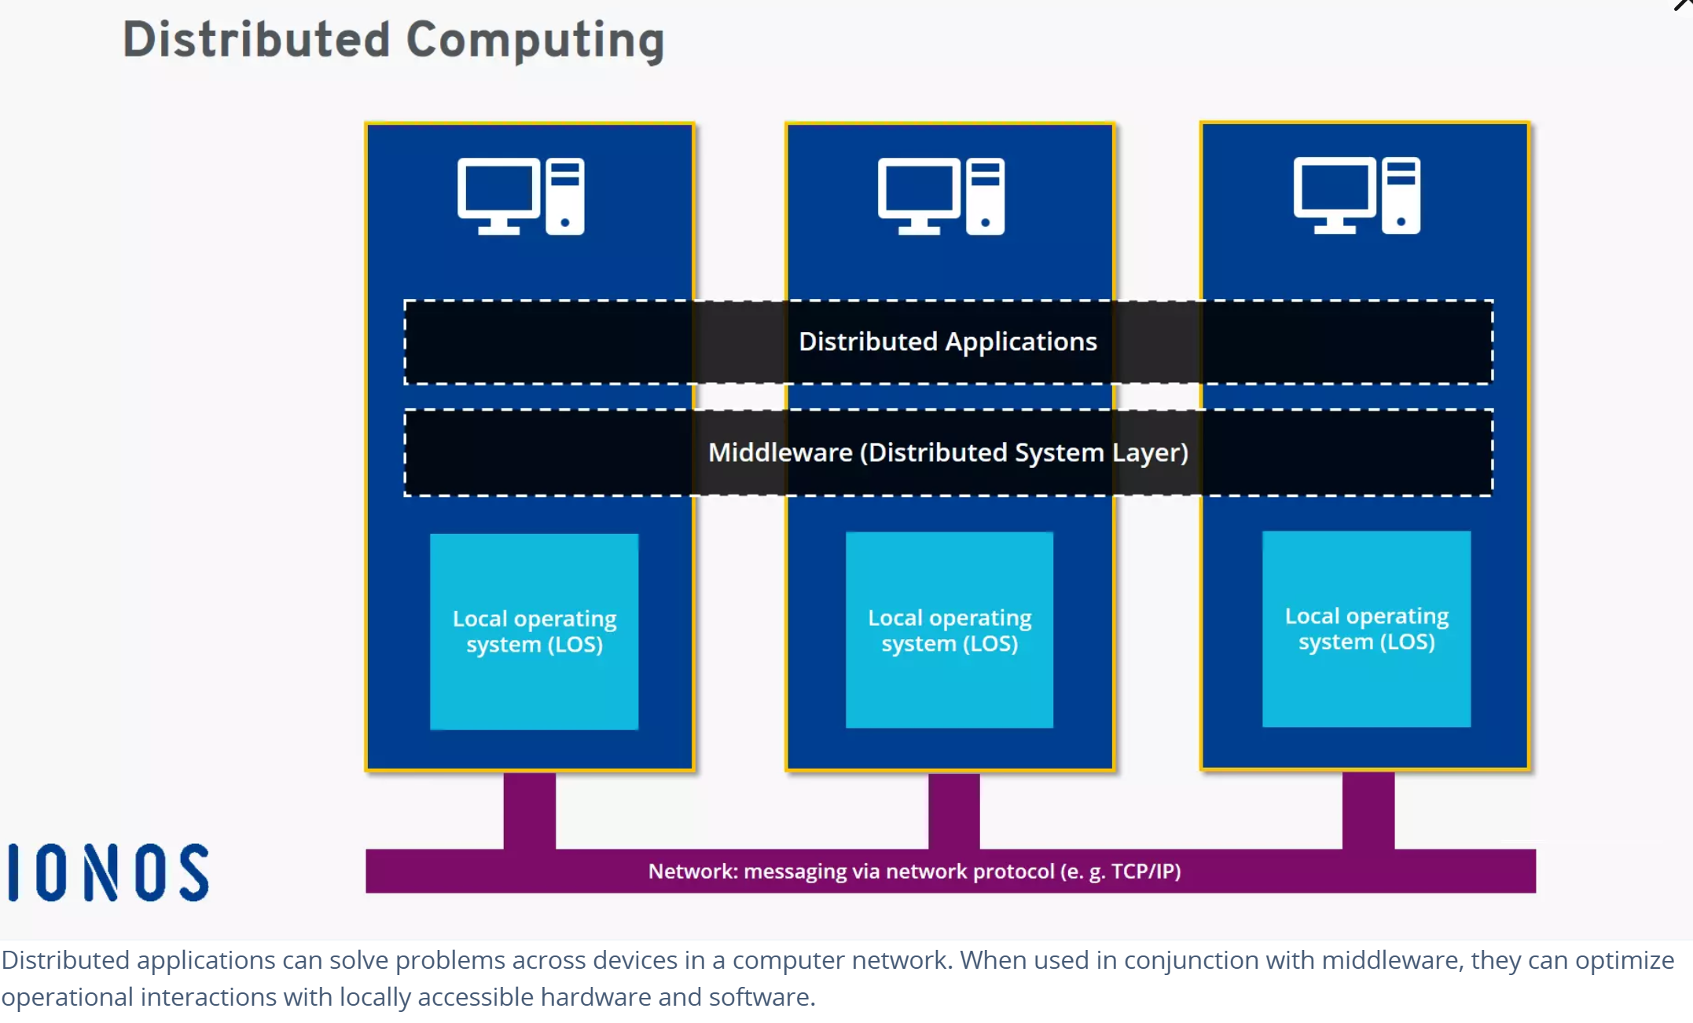

Slide 10
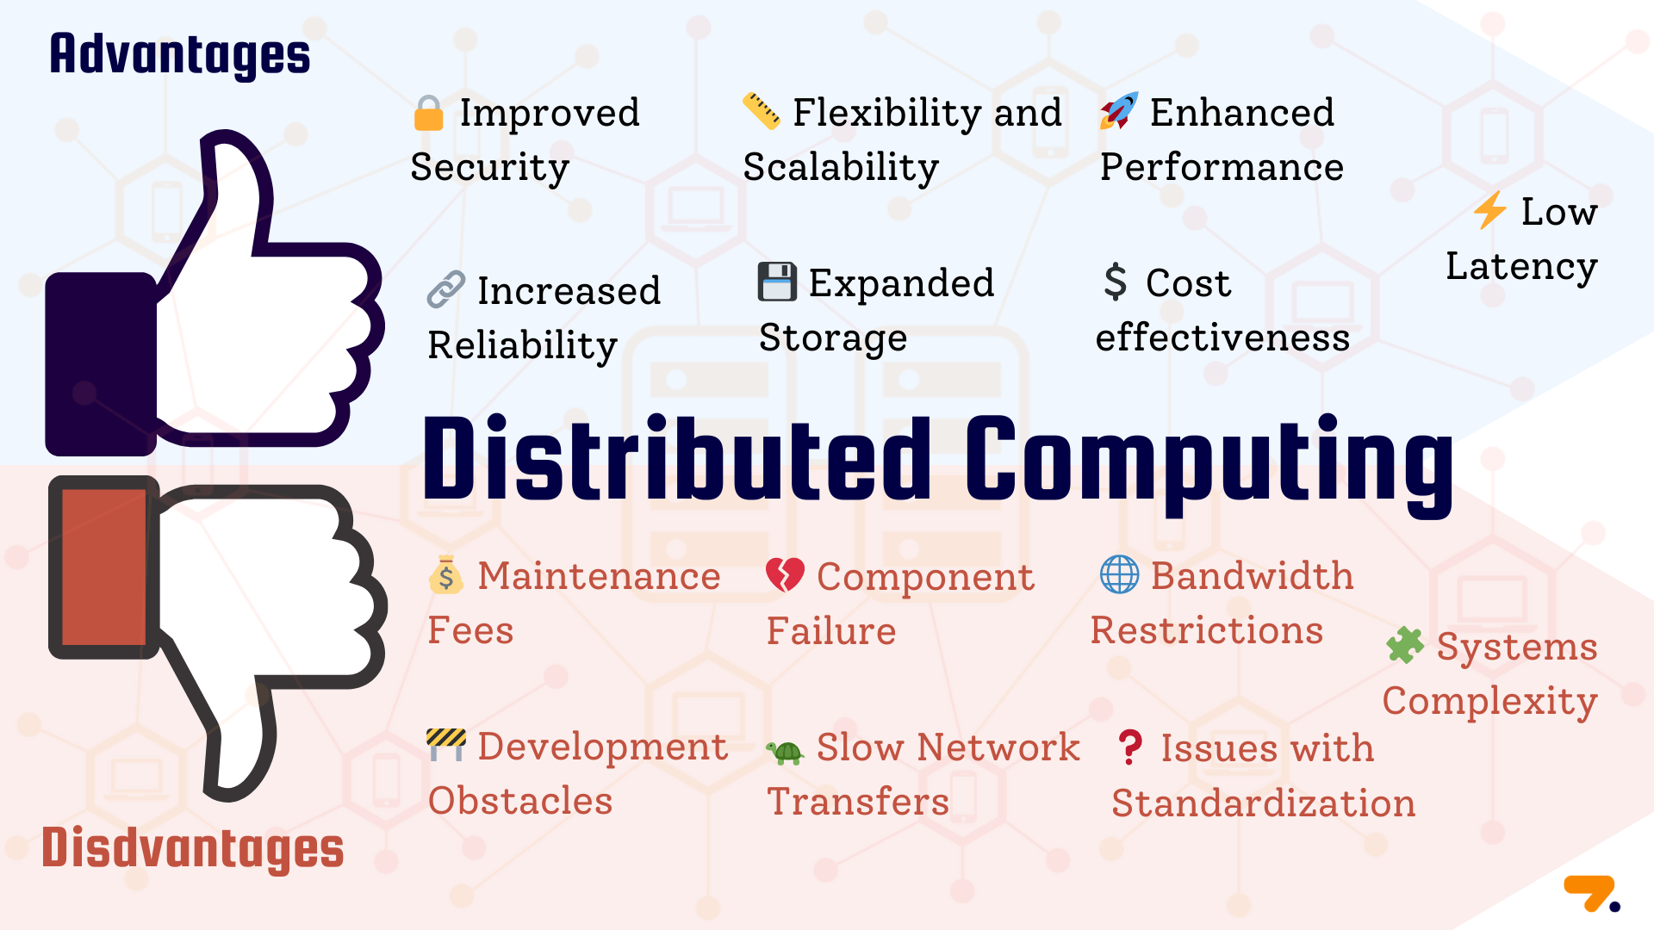

Slide 11
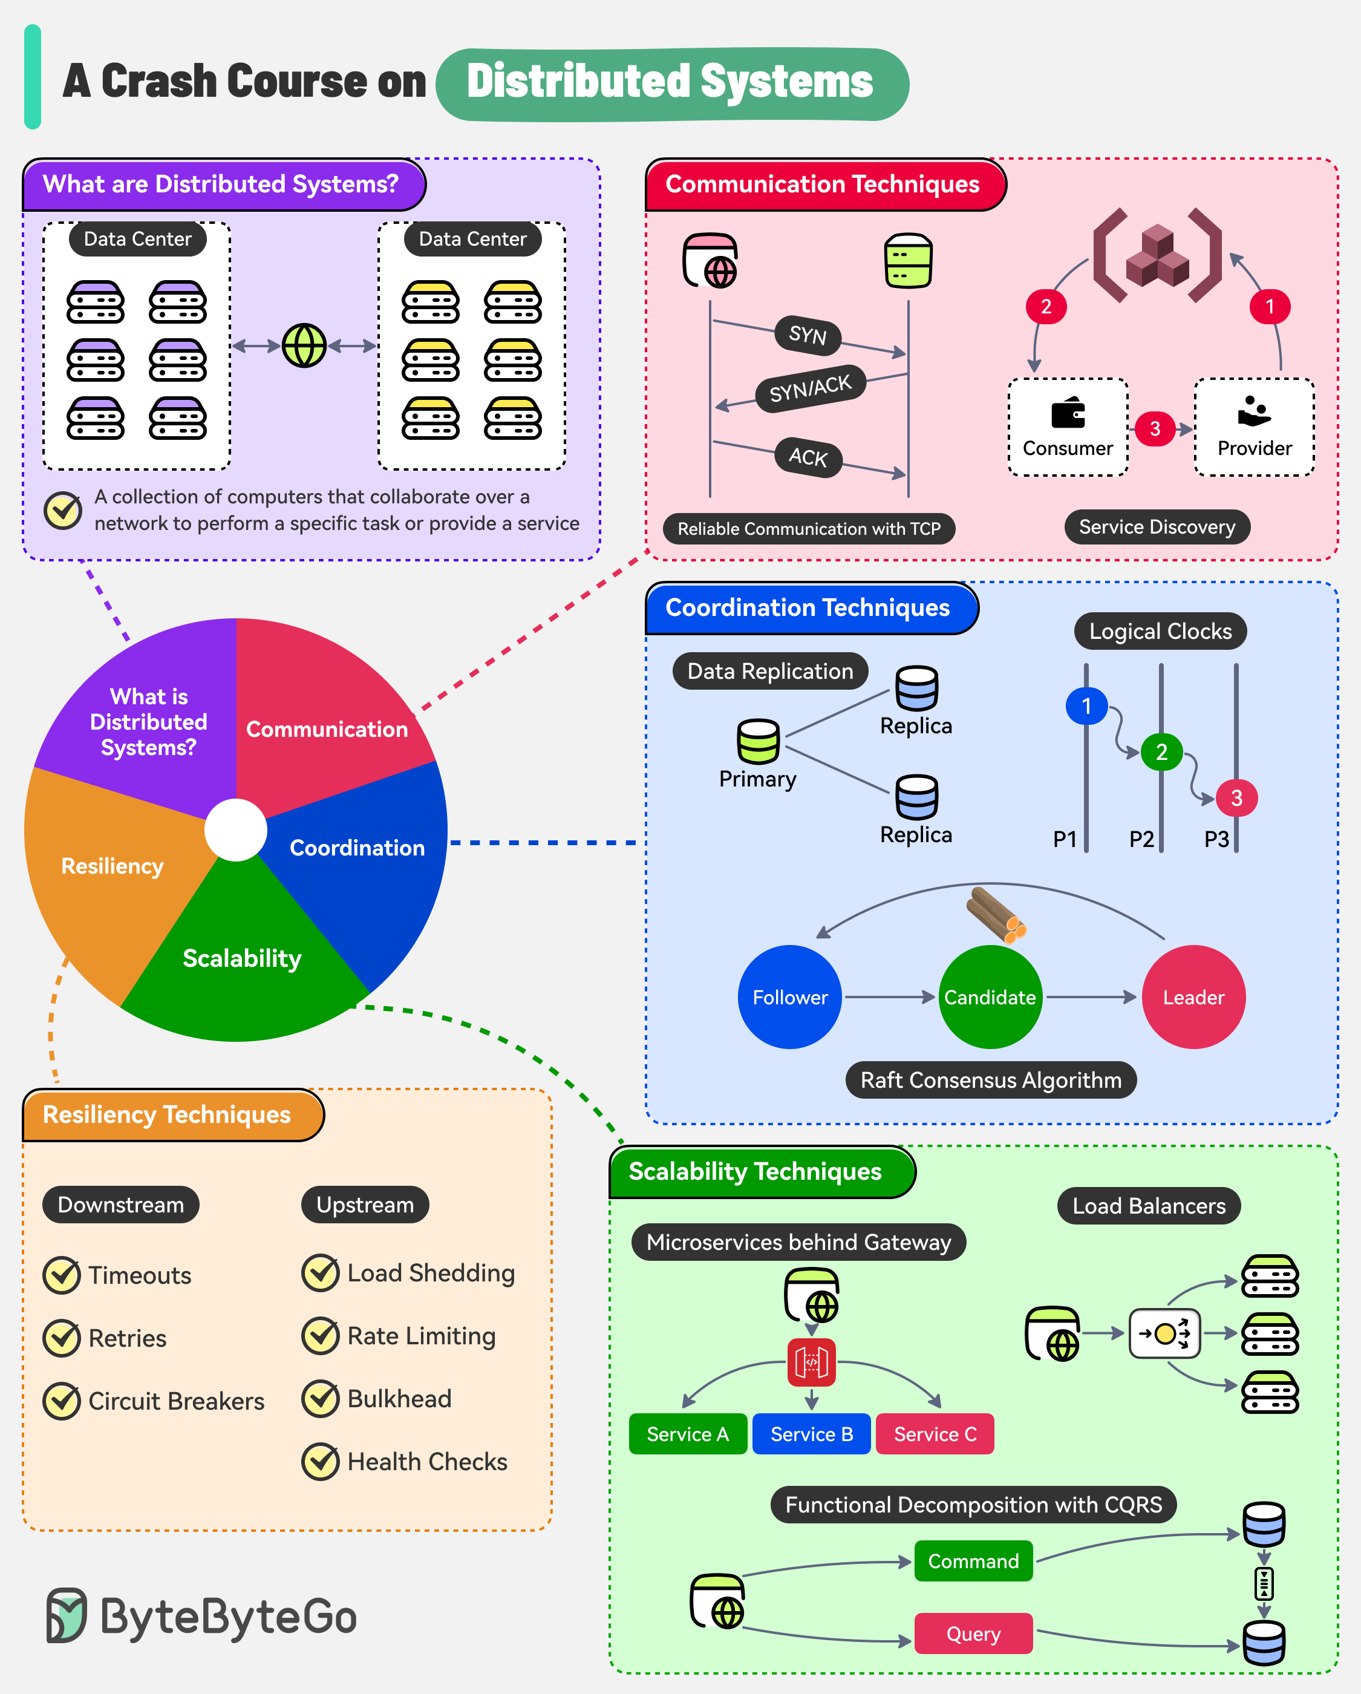

Slide 12
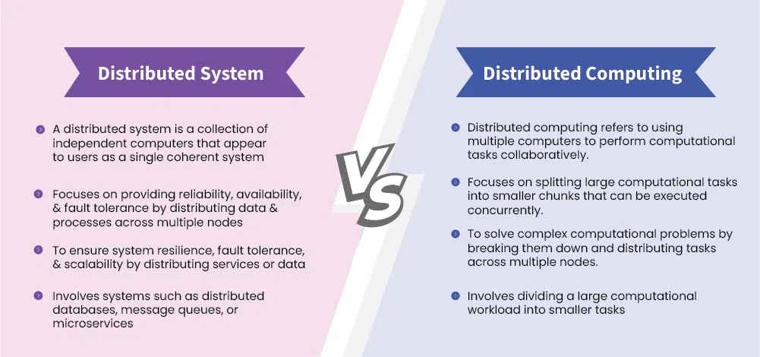

Slide 13
Aspect | Parallel Computing | Distributed Computing
Primary Goal | Increase speed, reduce execution time for a single, complex task. | Resource sharing, scalability, fault tolerance, solving large-scale problems.
System Architecture | Tightly-coupled. Processors connected via high-speed buses, shared memory, or specialized networks (InfiniBand). | Loosely-coupled. Computers (nodes) connected via standard networks (Ethernet, Internet).
Memory Model | Often Shared Memory. All processors access a common memory address space. | Often Distributed Memory. Each node has its own private memory; data is exchanged via message passing (e.g., MPI).
Communication & Coordination | Very low latency, very high bandwidth. Processes/threads require tight synchronization. | Higher latency, lower bandwidth. Nodes collaborate through asynchronous message passing.
User Perspective | Feels like using a single, powerful supercomputer. | Feels like using a single, coherent system (even though it's composed of many machines).
Scaling Method | Vertical Scaling (Scale-up). Adding more CPUs/cores within a single node. Limited by physical constraints. | Horizontal Scaling (Scale-out). Adding more commodity computer nodes. Theoretically unlimited.
Fault Tolerance | Typically weak. The failure of a single processor can cause the entire computation to fail. | Inherently strong. Designed with node failure in mind. Tasks can be restarted on other nodes if one fails.
Typical Applications | Scientific computing, 3D rendering, weather simulation, genomic sequence analysis. | Large web services (Google, Amazon), Big Data processing (Hadoop/Spark), blockchain, cloud platforms.
Programming Models/Tools | OpenMP (shared memory), MPI (distributed memory, for tight clusters), CUDA (GPU). | Hadoop, Spark, Akka, gRPC, and various cloud APIs (AWS, Azure).

Slide 14
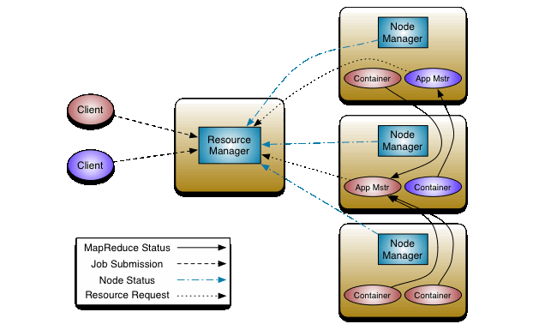
Example: Hadoop

Slide 15
Why Hadoop belongs to distributed Computing, but MPI not?
1. Primary Goal: Scale vs. Speed
Extreme Speed ​​vs. the Ability to Process Massive Data
2. System Architecture: Fault Tolerance vs. Performance (the most critical difference)
Parallel Computing (MPI): Tightly coupled. After tasks are distributed to multiple nodes, frequent communication and synchronization between nodes are required.
Hadoop: Loosely coupled. Its core design philosophies are "mobile computing is cheaper than moving data" and "hardware failures are the norm, not the exception."
3. Communication Model: Message Passing vs. Data Sharing
Parallel Computing (MPI): Frequent, low-latency, bidirectional communication between processes is achieved through a message passing interface.
Hadoop MapReduce: There is almost no communication between processes. This "share nothing" architecture is a typical distributed system design.
4. Problem Domain: Single Complex Task vs. Decomposable Batch Tasks
Parallel Computing: Excels at solving a single, complex problem that requires a high degree of coordination (such as simulating an entire weather system). Hadoop MapReduce excels at batch processing problems that can be clearly decomposed into a large number of independent subtasks (such as counting the number of visits to each URL in a massive log). Each subtask processes a small portion of the data and does not depend on the intermediate results of other subtasks.
An analogy: MPI is like a symphony orchestra. Hadoop is like a courier company's sorting center.

Slide 16
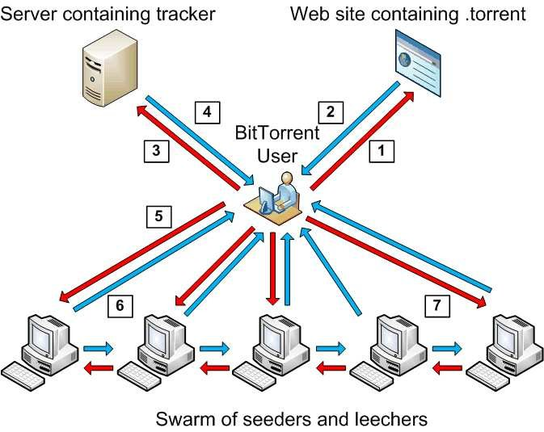
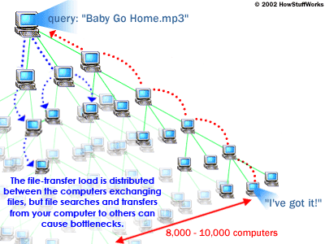
Example: P2P Download

Slide 17
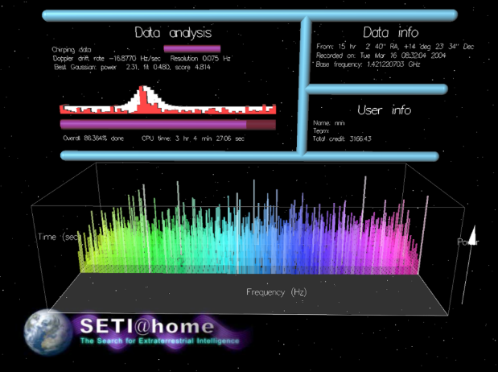


Example: the ‘Slowest’ Distributed System
Search Alien Civilization, using volunteer PCs on the internet
Found nothing…
Fermi Paradox

Slide 18
What is Hadoop?
An open-source, reliable, and scalable distributed computing framework developed by the Apache Foundation.
Core ideas: Derived from Google's GFS and MapReduce papers.
Key advantages: High fault tolerance, high throughput, and low cost (using commodity hardware).

Slide 19
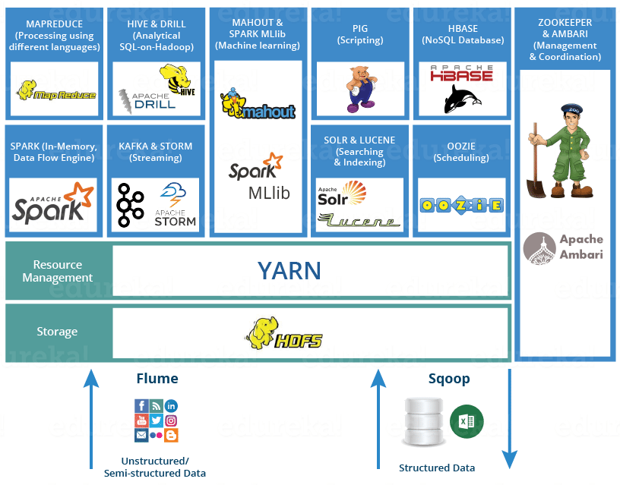
Hadoop Ecosystem

Slide 20
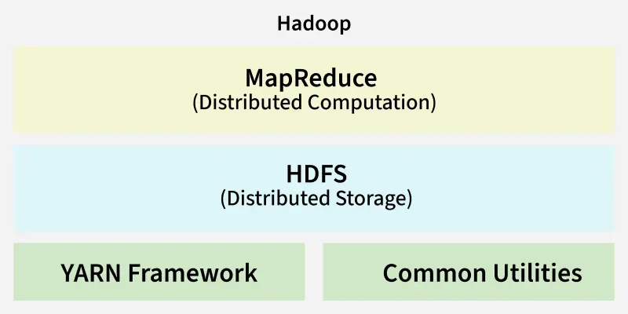
Hadoop Architecture

Slide 21
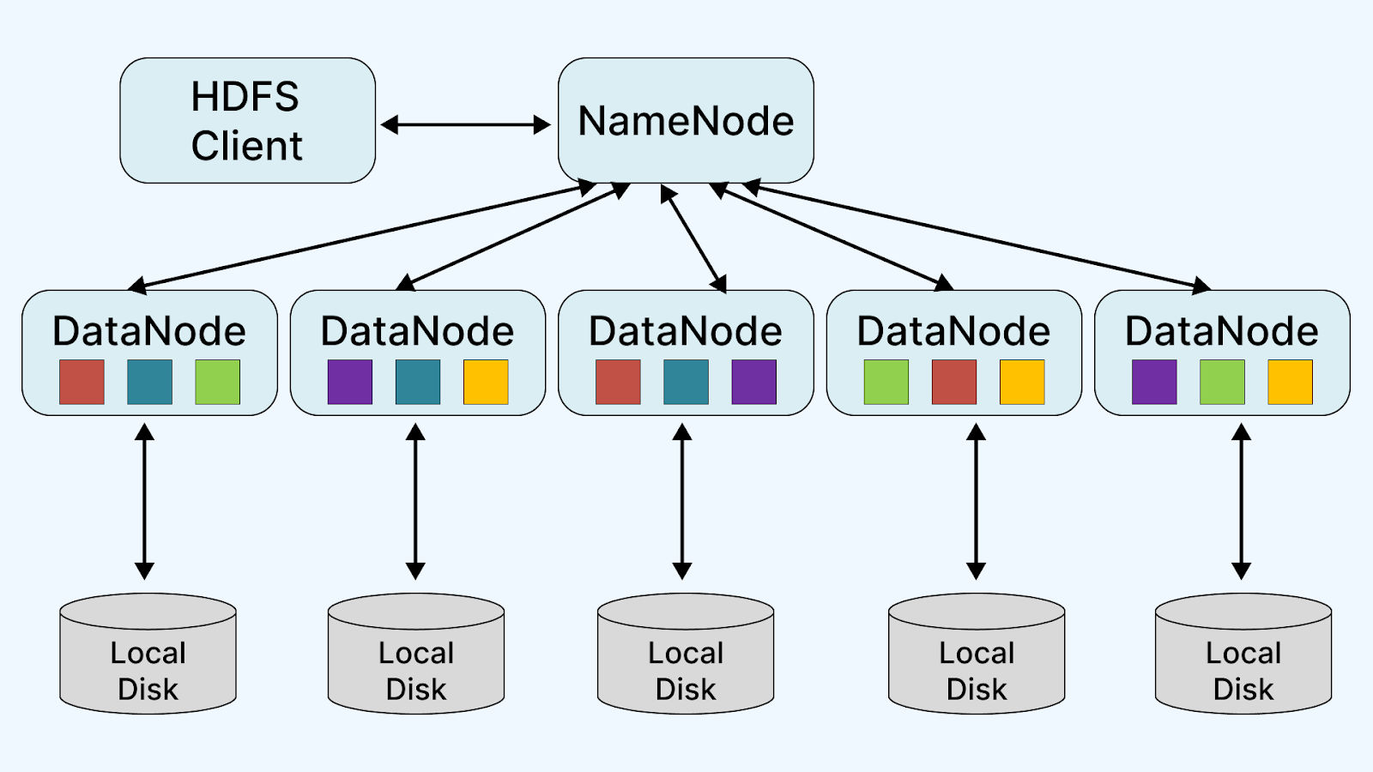
Hadoop Cluster

Slide 22
What is MapReduce?
A programming model and computing framework for large-scale data processing.
The core concept is "divide and conquer."
Break down complex tasks into multiple smaller tasks, process them in parallel across a cluster, and then aggregate the results.

Slide 23
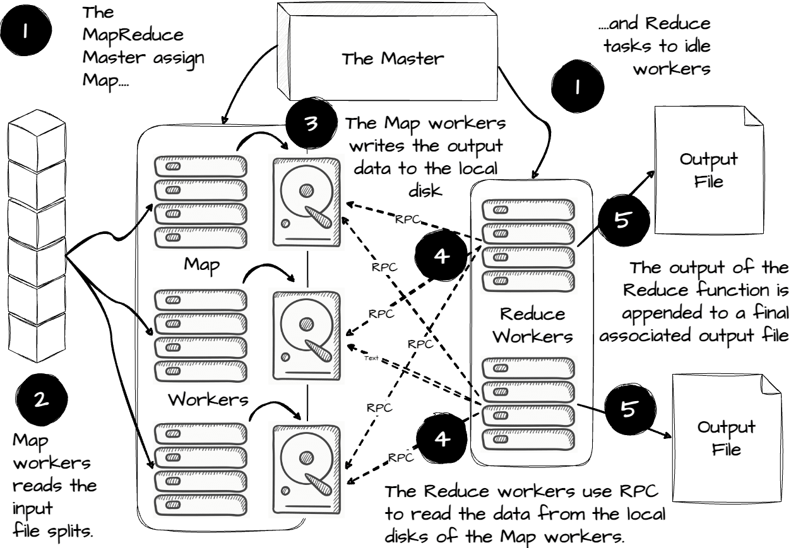

Slide 24
A vivid example: counting word frequencies in a library
Question: How can we quickly count the number of occurrences of each word in all the books in the library?
Traditional method: One person counts each book one by one. Too slow!
MapReduce Method:
Step 1: Map: Have multiple people (workers) each be assigned a few books, and each count the number of occurrences of a word in their own book, outputting an intermediate result such as (word, 1).
Step 2: Shuffle & Sort: Group and sort all intermediate results by word, so that all records for the same word are grouped together.
Step 3: Reduce: Have multiple people (workers) each be responsible for a subset of words, and sum up all the counts for each word to produce the final result (word, total counts).

Slide 25
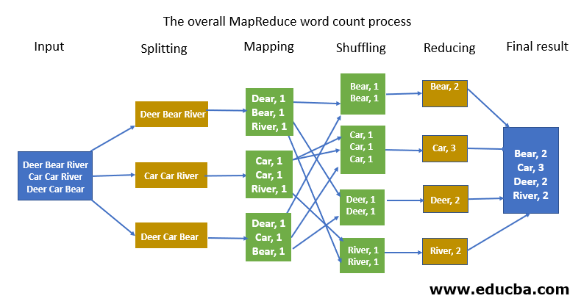

Slide 26
Code
https://www.geeksforgeeks.org/python/hadoop-streaming-using-python-word-count-problem/

Slide 27
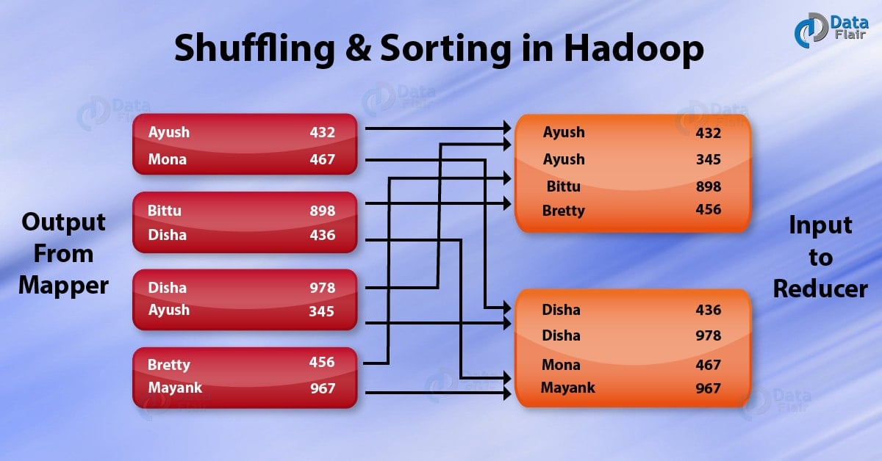
MapReduce = Map + Shuffle + Reduce

Slide 28
Querying Big Data
Transaction processing systems that need very high scalability
Many applications willing to sacrifice ACID properties and other database features, if they can get very high scalability
Query processing systems that
Need very high scalability, and
Need to support non-relation data

Slide 29
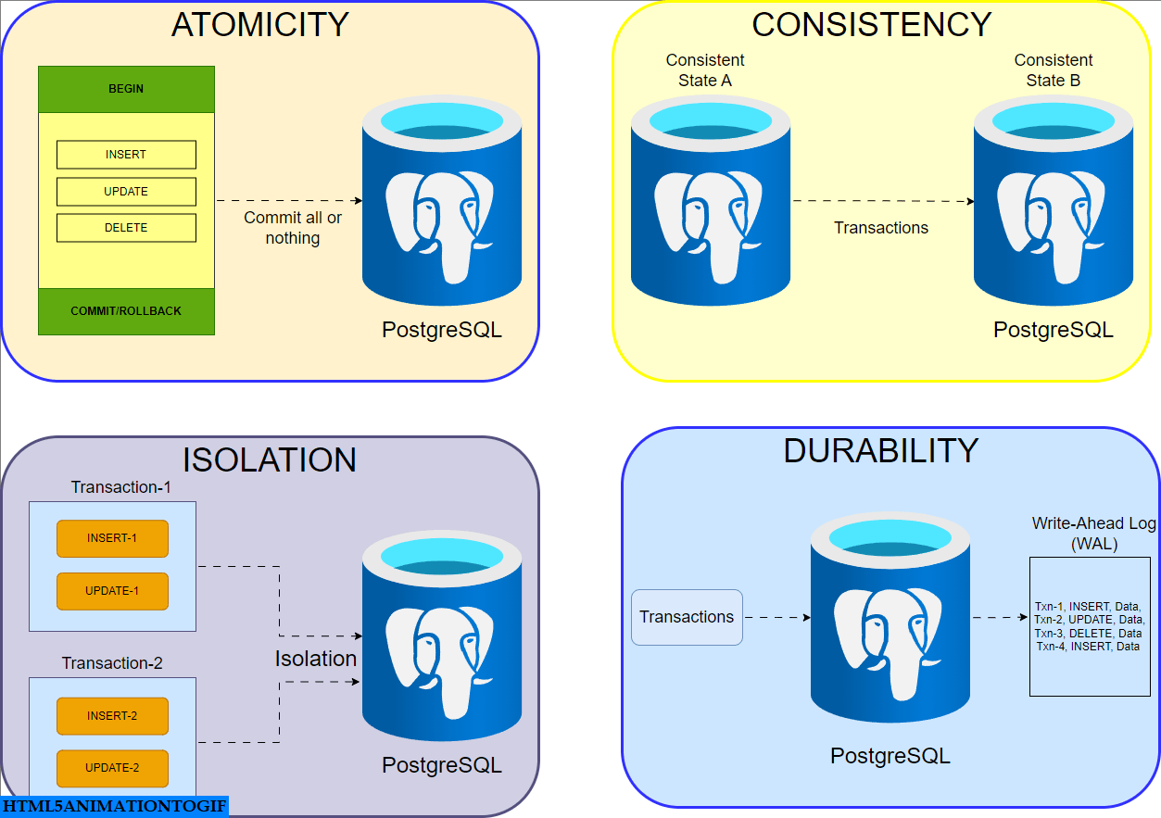
ACID

Slide 30
Example of ACID
Let's combine the four ACID properties into one example:
Operation: Transfer 100 yuan from Account A to Account B.
Atomicity: Ensures that the two operations—"deduct 100 from A" and "add 100 to B"—are bundled together. They either both succeed or both fail.
Consistency: Ensures that the total amount in the database remains unchanged before and after the transfer (the sum of A and B remains the same), and account balances do not become negative.
Isolation: During the transfer process, if another transaction queries the balance of Account A, it will either see the balance before the transfer or the balance after the transfer, but never an "intermediate state" (for example, seeing that A has been debited but B has not yet received the money).
Durability: Once the bank system prompts "Transfer Successful," the result is permanently effective and will not disappear due to a system restart.

Slide 31
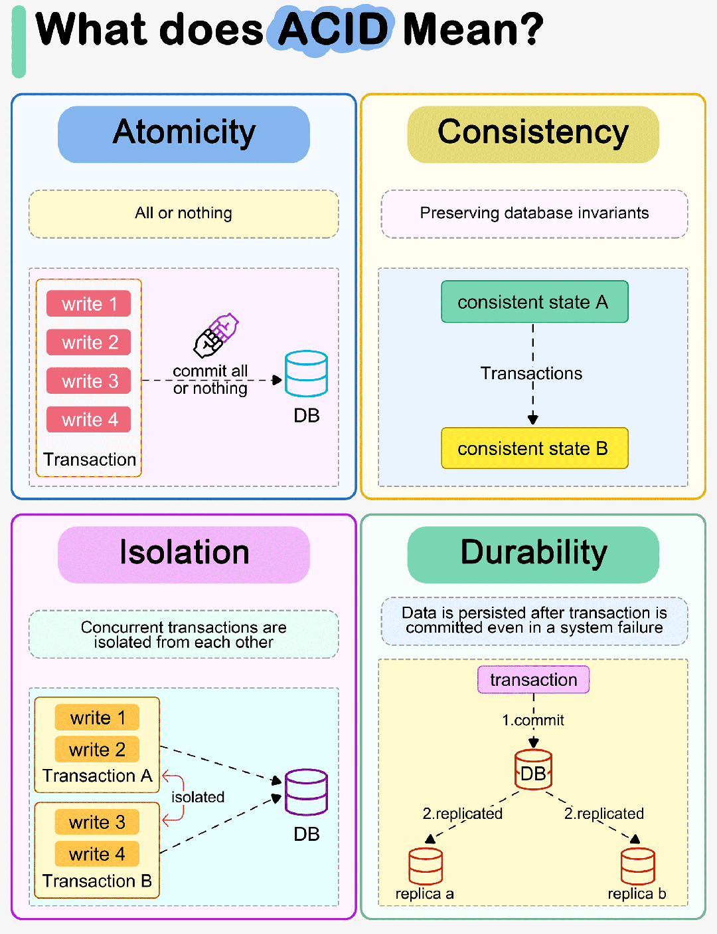
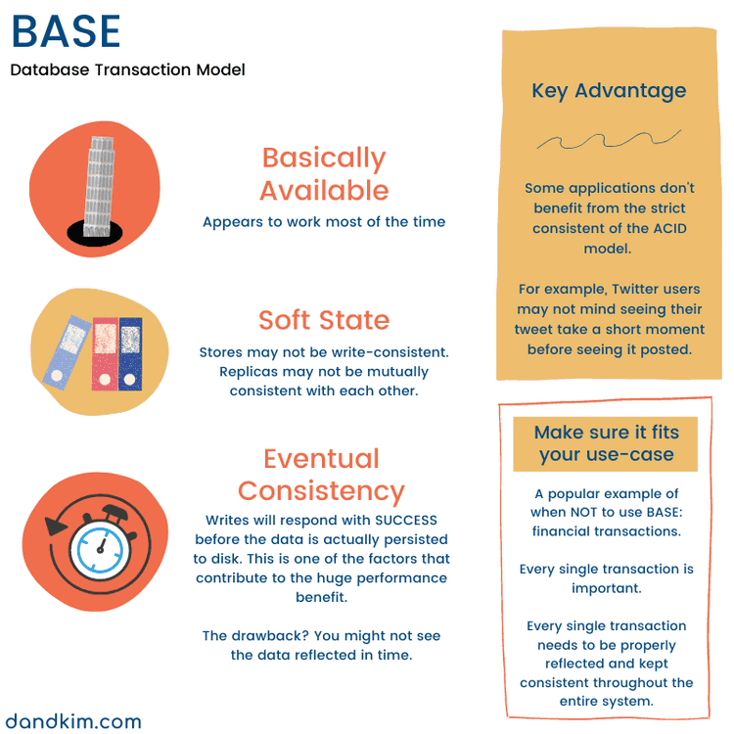
ACID vs. BASE

Slide 32
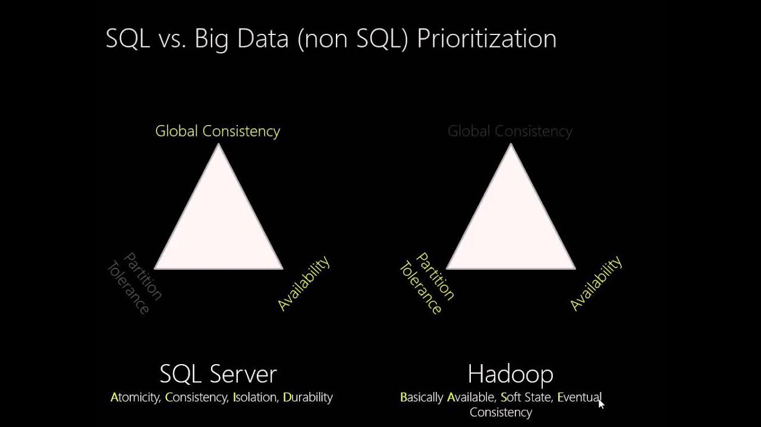
BASE for Hadoop

Slide 33
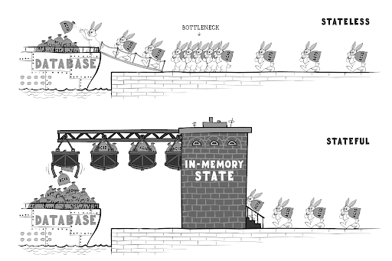
Stateless

Slide 34


Slide 35
Example: Unstructured Data
Variety: This type of data can include a wide range of formats, such as:
Text documents (e.g., emails, reports, articles)
Multimedia files (e.g., images, audio, video)
Social media content (e.g., posts, comments, tweets)
Web pages and blogs

Slide 36
Applications
Unstructured data is already being used across industries:
Healthcare: Doctors use unstructured patient records, lab notes and imaging reports to diagnose and personalize treatment.
Retail: Analyzing customer reviews and social media comments to improve product quality and customer experience.
Finance: Processing news feeds, analyst reports and customer emails to manage risk and improve investment decisions.
Legal: Automating document review and e-discovery in law firms through text mining.
Media & Entertainment: Recommending content based on viewing habits, comments and user preferences.

Slide 37
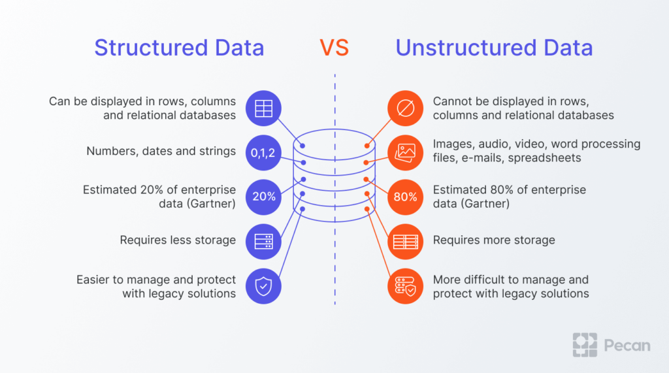
Unstructured Data vs Structured Data

Slide 38
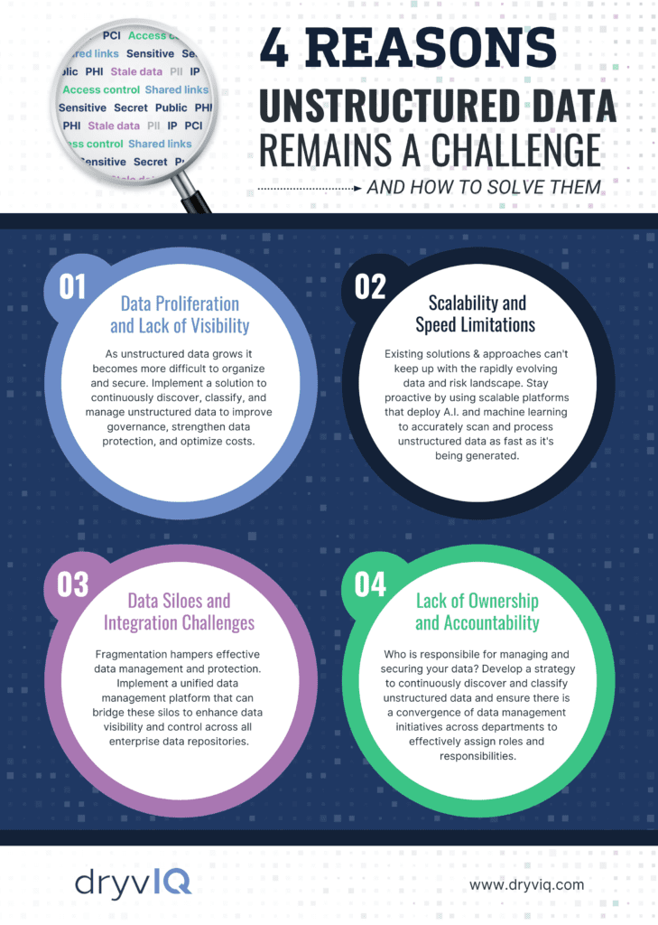

Slide 39
HDFS: Design Goals
Storing extremely large files (GB/TB levels).
Streaming data access (write once, read many times).
Deployment on inexpensive commodity hardware.
High fault tolerance.

Slide 40

NameNode (Master): "Archiver".
Responsibilities: Manages the file system namespace (metadata) and maintains the file system tree.
Does not store actual data.
DataNode (Slave): "Storekeeper".
Responsibilities: Stores actual data blocks and responds to client read and write requests.

Slide 41
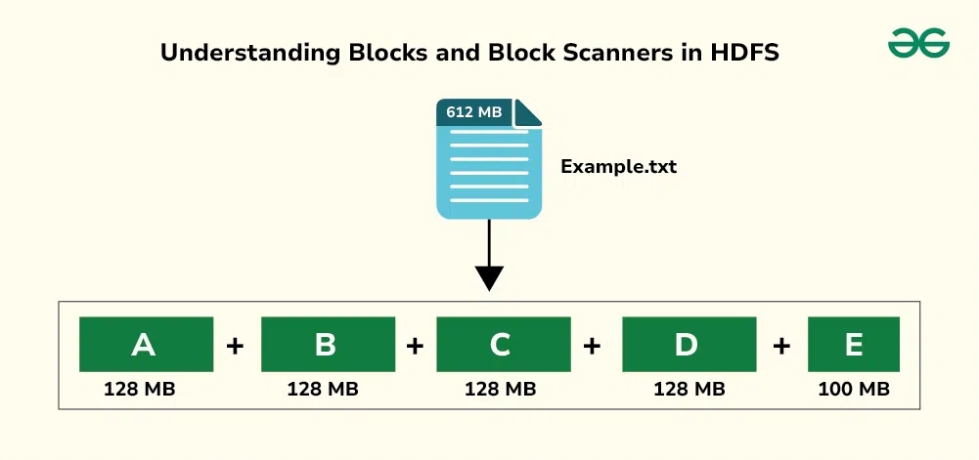
HDFS Block

Slide 42
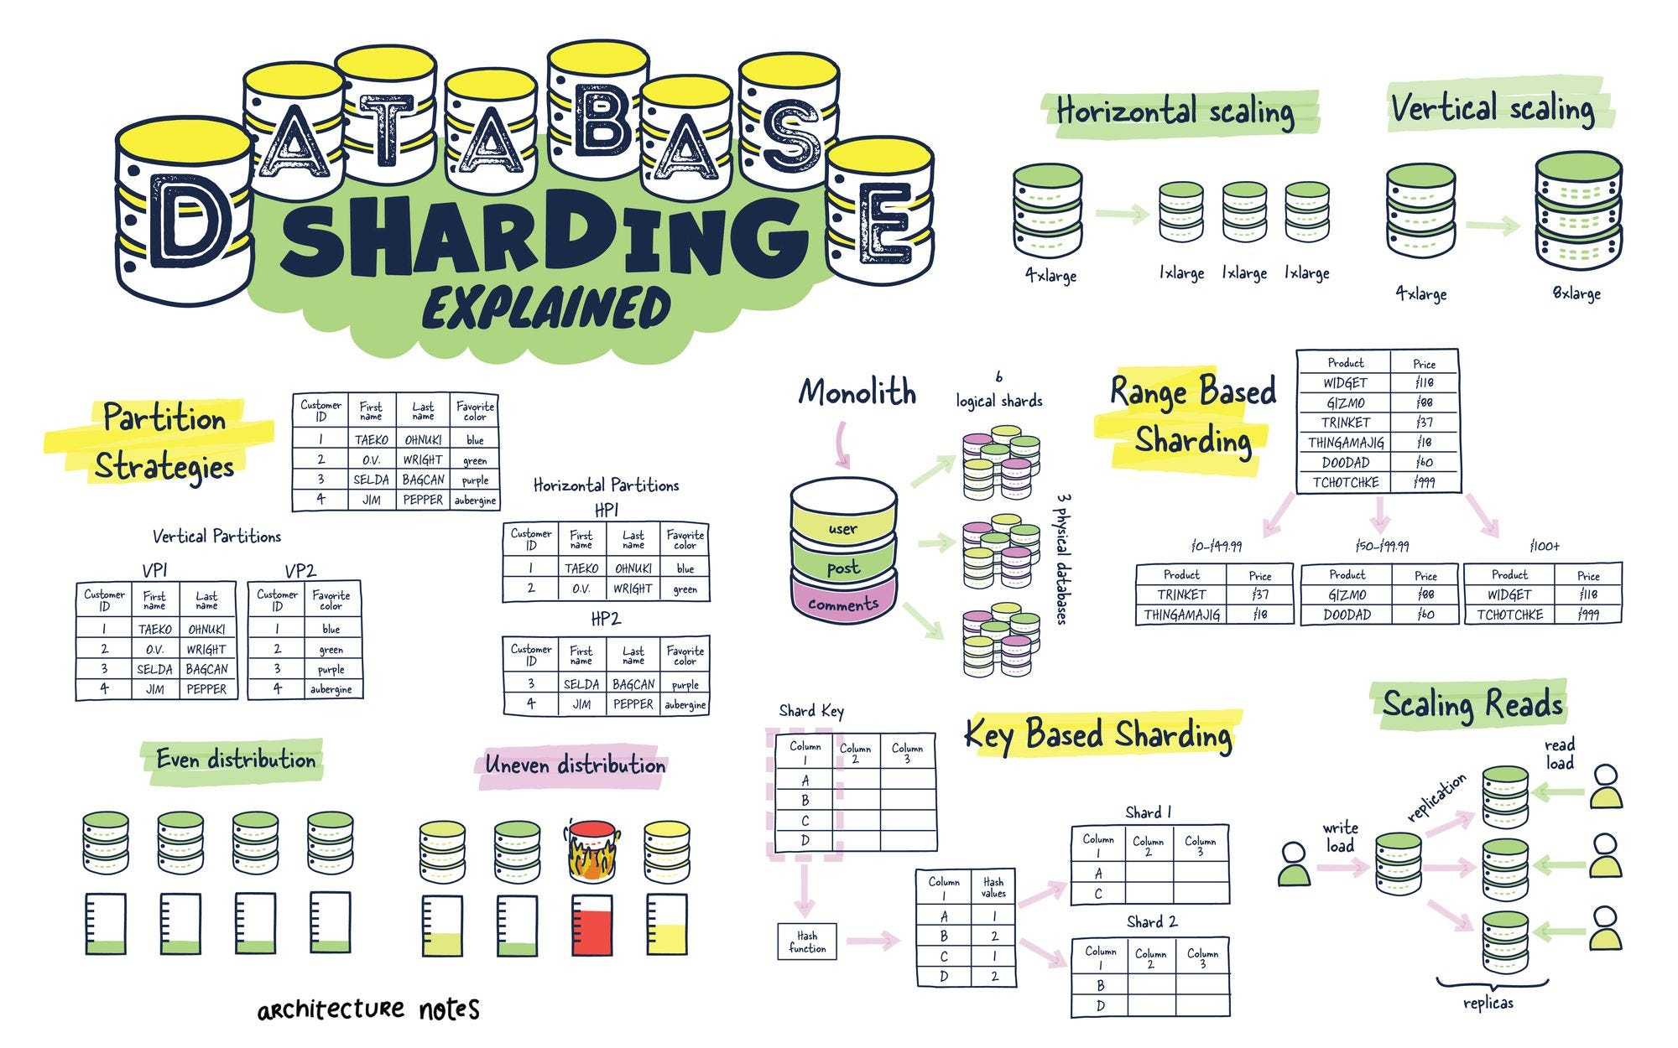

Slide 43
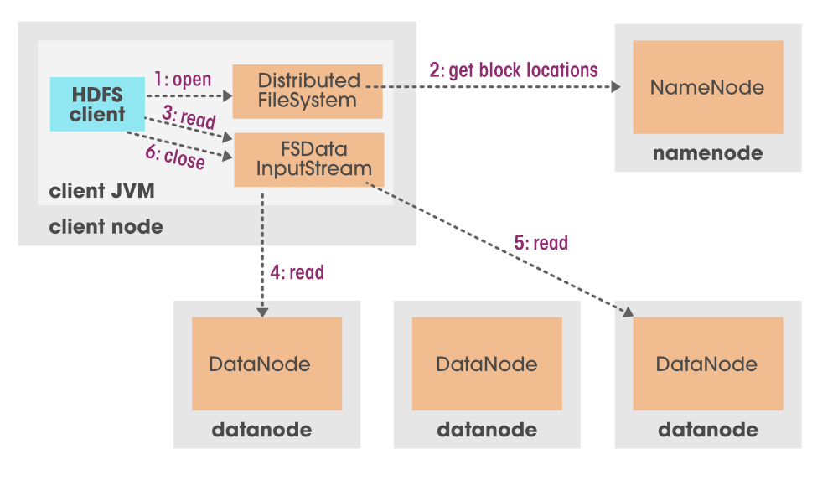
Read Process

Slide 44
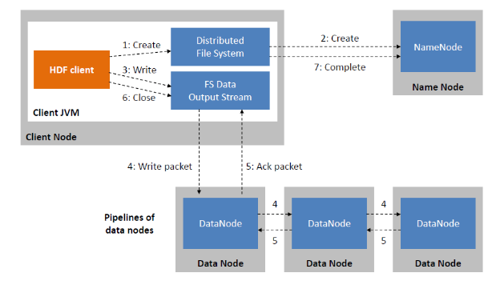
Write Process

Slide 45
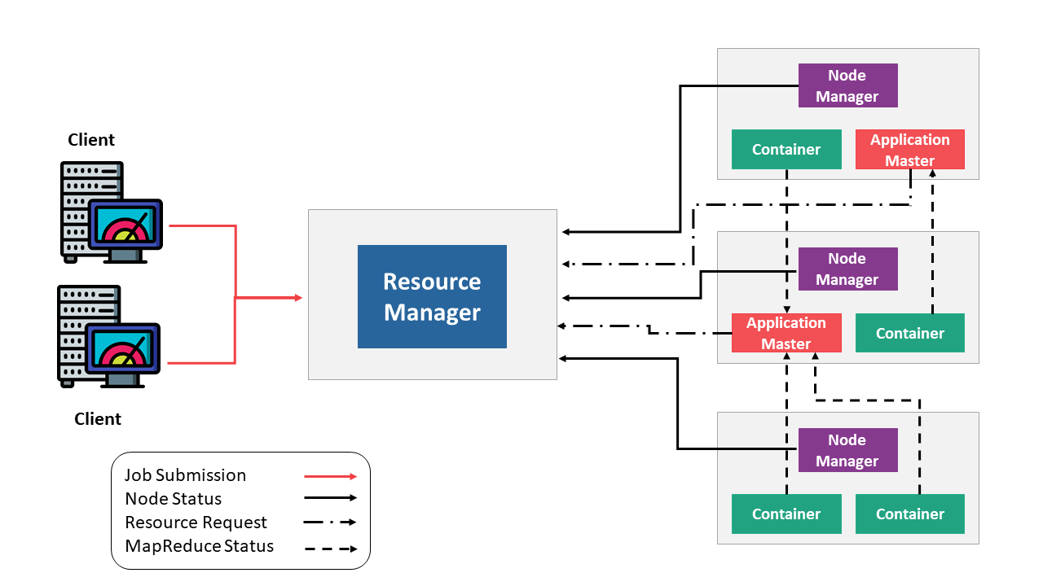
YARN

Slide 46
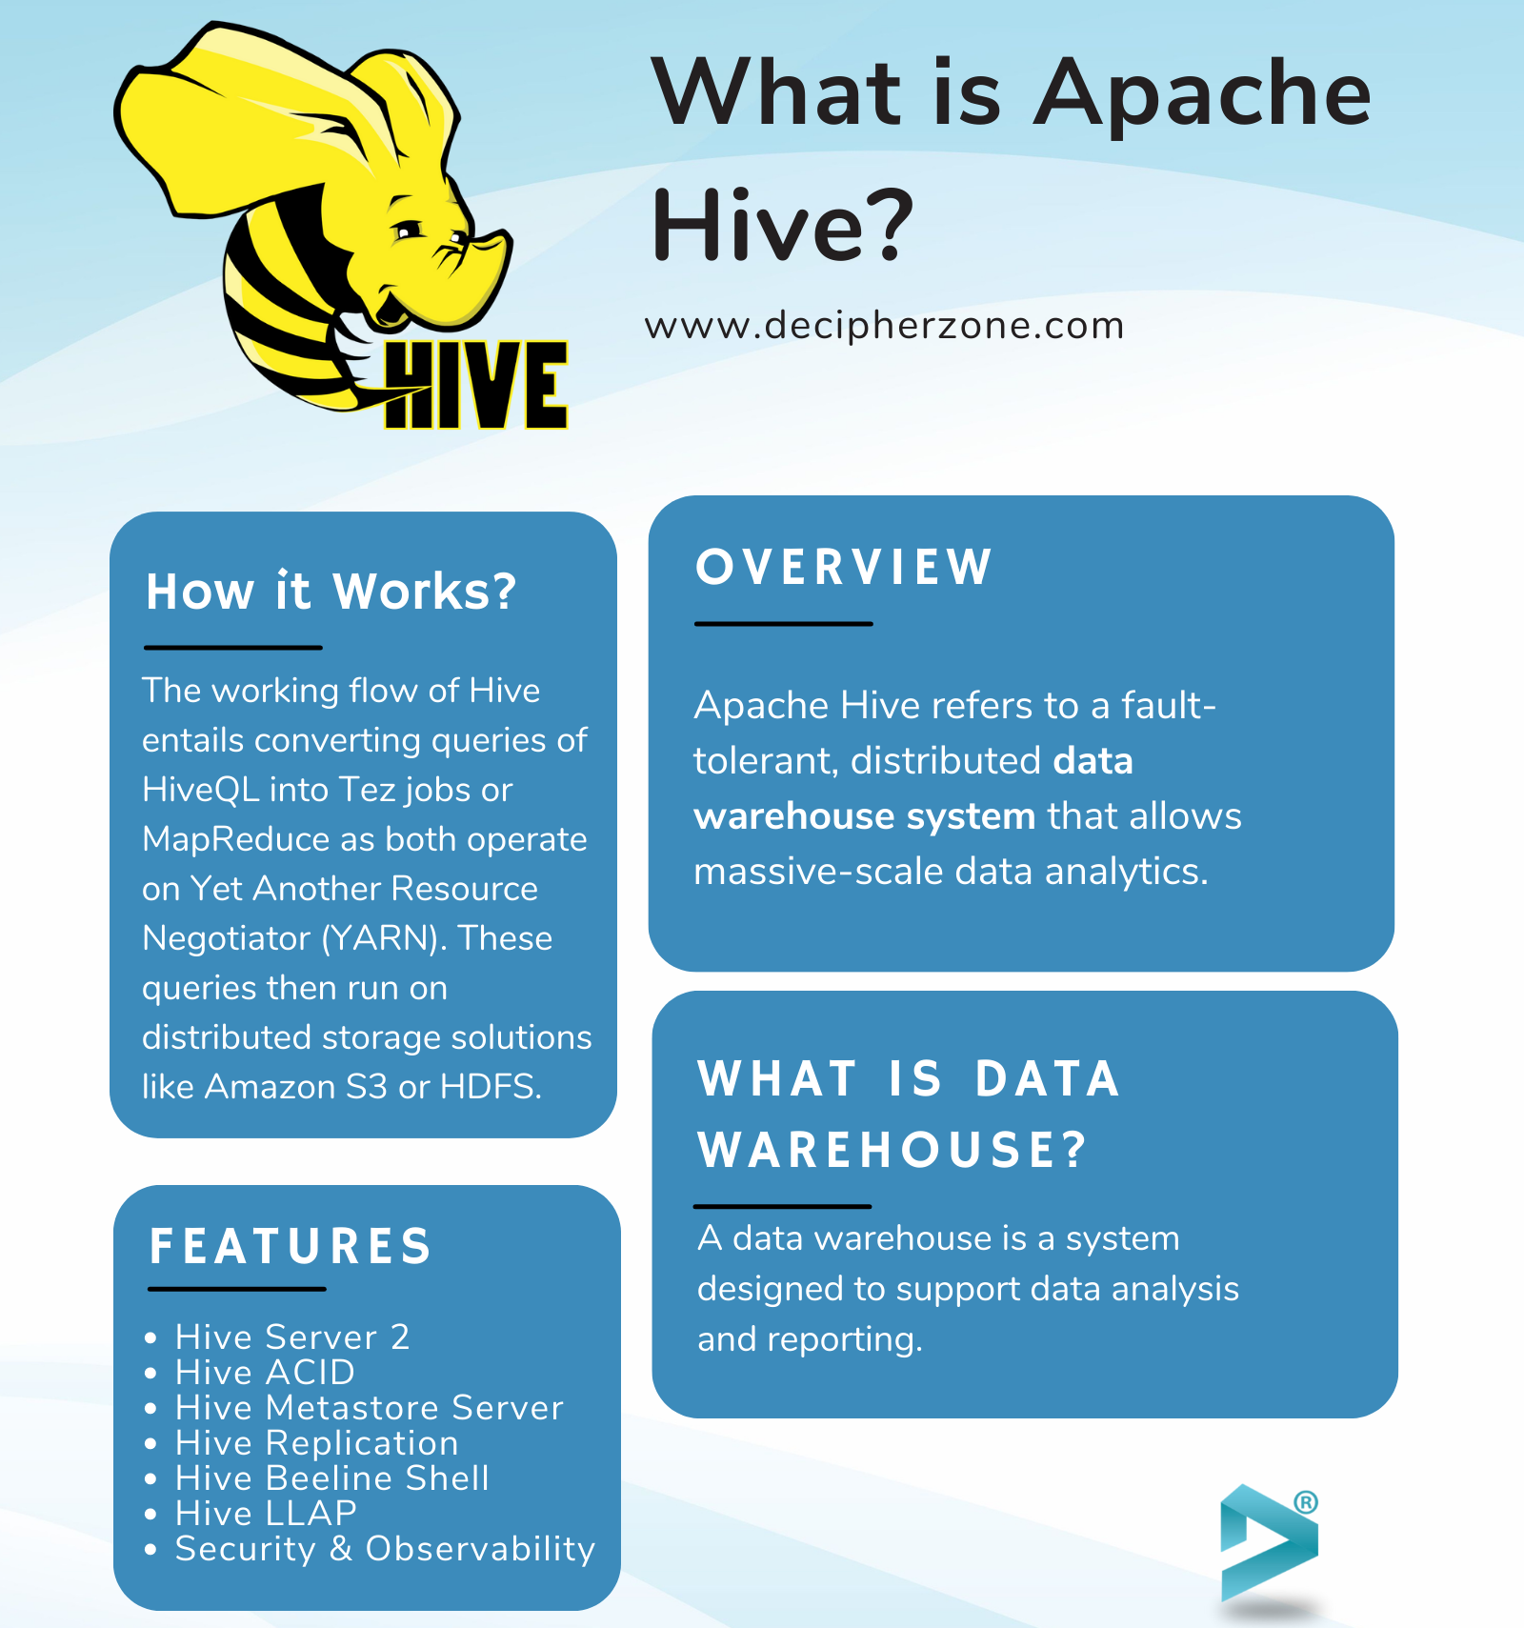

Slide 47
Example
https://www.simplilearn.com/tutorials/hadoop-tutorial/hive

Slide 48

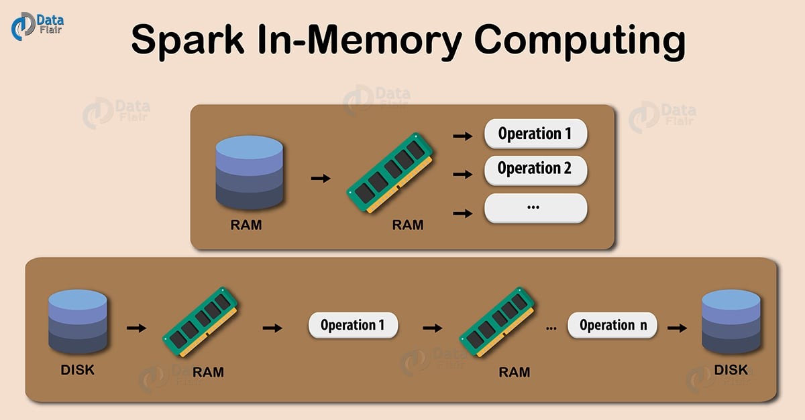
Spark: In-Memory Computing

Slide 49
Core Innovation
Core Innovation 1: In-Memory Computing
Spark stores intermediate data and results in memory as much as possible, spilling them to disk only when memory is insufficient or persistence is required.
Analogy: MapReduce is like a mathematician who records every step of a calculation with pen and paper (on disk), while Spark is a master of mental arithmetic (in-memory).
Core Innovation 2: Unified Engine
Spark provides a powerful general-purpose execution engine that supports multiple computing models, such as SQL queries, stream processing, machine learning, and graph computing.
Value: Users only need to learn a single framework to solve a variety of problems, reducing learning costs and system complexity.

